Slide 1
AI-Based Intrusion Detection and Prevention System (IDPS)

Slide 2
Group Members
Serial No. | Name | Roll No.
01 | Neha | 22041556-009
02 | Sohaib Arshad | 22041556-046
03 | Shiza Nadeem | 22041556-060

Slide 3
Contents
Introduction
Proposed System
Objectives
Goals
Funtional Units
Diagrammatic View of Project
Gantt Chart
Hardware & Software specifications
Tools & Technologies
References

Slide 4
Introduction
Overview:
The AI-Based Intrusion Detection and Prevention System (IDPS) secures home and small office networks using machine learning to detect and prevent cyberattacks in real time.
Problem Statement:
Traditional intrusion detection systems only identify attacks but cannot stop them, leaving networks vulnerable to ongoing or repeated threats.
Solution:
The proposed IDPS uses artificial intelligence to both detect and prevent attacks such as DoS, Probing, U2R and R2L.

Slide 5
Proposed System - I
The project aims to develop an intelligent desktop-based system that detects and prevents cyberattacks on home and small office networks using machine learning.
Key features of the proposed system include:
AI-Based Detection:
Identifies abnormal network behavior using machine learning algorithms trained on real attack data using KDD99CUP Dataset.
Intrusion Prevention
Takes automatic actions such as blocking or limiting malicious traffic once an attack is detected.
Attack Reports
Provide detail reports of attacks.
Lightweight and Efficient
Runs effectively on average computer hardware without requiring big setup.

Slide 6
Proposed System - II
Real-Time Monitoring
Provides instant alerts and clear insights for administrators.
Secure Communication
Ensures network data integrity and privacy at all times.

Slide 7
Objectives
The objectives of IDPS are as follows:
Detect Network Intrusions
Prevent Malicious Activities
Enhance Network Security
Reduce False Positives
Enable Real-Time Monitoring
Support System Scalability
Ensure Data Integrity

Slide 8
Goals
The goals of IDPS are as follows:
Create a User-Friendly Interface
Detect and Prevent Attacks
Enhance Network Protection (Quick detection and Prevention)
Improve Response Time
Minimize False Alerts (Increase system accuracy)
Protect Data and Privacy
Ensure Scalability and Efficiency

Slide 9
Functional Units - I
User Interface(UI)
User Configuration
Detection Output Display
Prevention Status View
Alert Notifications
Log Access
Model Update Control

Slide 10
Functional Units - II
Application Logic (Backend)
Data Processing and Analysis
Model Integration
Detection and Prevention Management
Alert and Logging System

Slide 11
Functional Units - III
Data Storage
User Configuration Data
Detection and Prevention Logs
Model and Training Data
Knowledge Base Data

Slide 12
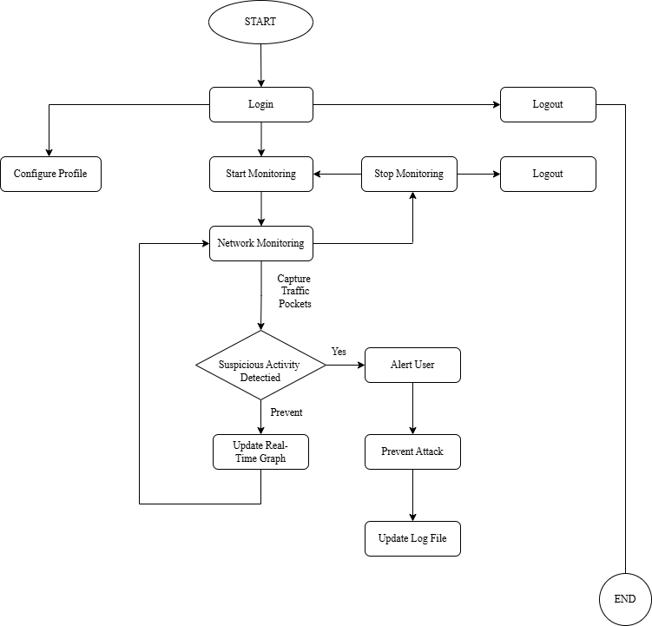
Diagrammatic View of IDPS

Slide 13
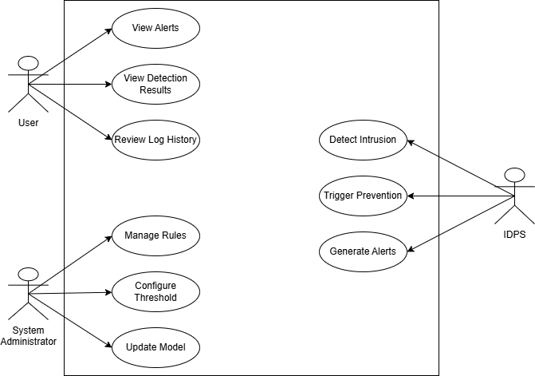
Use Case Diagram

Slide 14
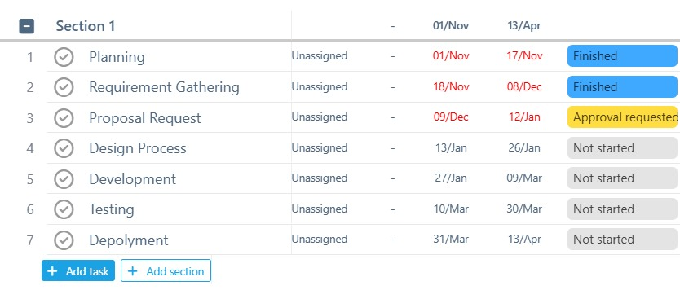
Gantt Chart - I

Slide 15
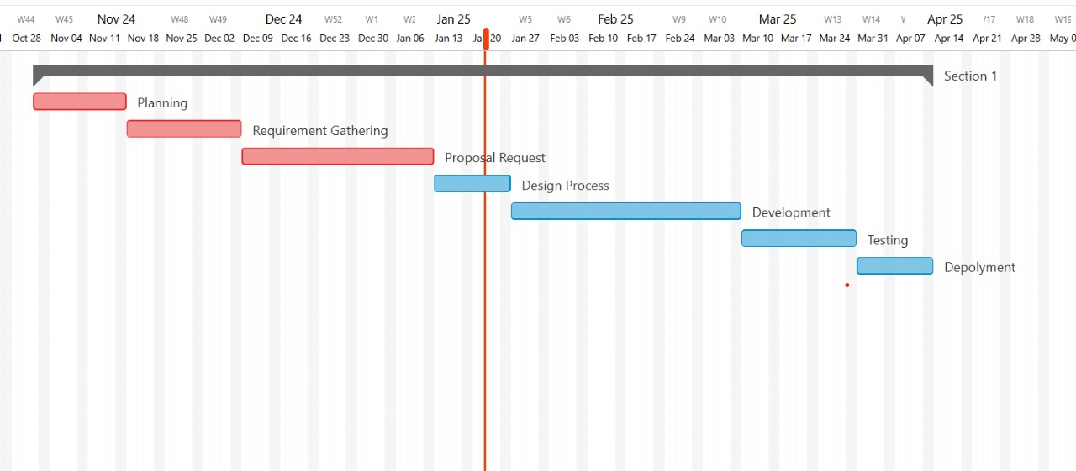
Gantt Chart - II

Slide 16
Hardware & Software Specifications
Hardware Specifications
RAM: Minimum 8Gb.
Processor: Intel Core i4 and Above.
Hard Disk: At least 128GB.
Network: Stable internet connection for dataset access and updates.
Software Specifications
Operating System: Minimum Window 10.
Browser : Google Chrome.

Slide 17
Tools & Technologies - I
Tools
Visual Studio: A code editor for development.
MS Word: Text editor for documentation.
Draw.io: To draw diagram.
Python(3.9+): Used to build the detection and prevention logic,

Slide 18
Tools & Technologies - II
Technologies
Frontend:
• •PyQt5 & Qt Designer: (Used to create the desktop interface for user interaction)
• Message Box: (Used to display notifications, alerts, or system messages to the user)
Tree View: (for Tables)
Backend:
• •Python (3.9+) Libraries: (Core programming language used for overall system)
• Scikit-learn (Used for training and testing machine learning models)
• Pandas (Used for data loading, cleaning, and manipulation)
•

Slide 19
Tools & Technologies - III
•NumPy (Used for numerical operations and array handling)

Slide 20
References
https://www.kaggle.com/datasets/hassan06/nslkdd

Slide 21
Attacks Detected

Slide 22
THANK YOU

